Slide 1
predIction of Energy consumption using automl

Slide 2
Problem statement
I am going to PredIct energy consumption of IoT sensors data ,
the dataset covers from 01-04-2018 to 30-09-2018 .

Slide 3
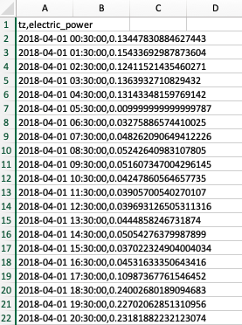
Dataset

Slide 4
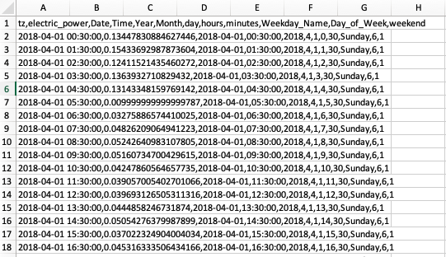
Dataset after preprocessing

Slide 5
Tools and technology
Pycharm 2020
Virtual box
Ubuntu
Mac os
Docker
H20 Driverless AI
H20 Flow
AWS

Slide 6
Automl frameworks
TPOT
Autosklearn
H20 automl
Driverless AI

Slide 7
TPOT
Split | Training Set | Testing | R2 Score
70-30 | 70 | 30 | 0.87
75-25 | 75 | 25 | 0.86
80-20 | 80 | 20 | 0.90
TPOT is a Python Automated Machine Learning tool that optimizes machine learning pipelines using genetic programming. TPOT will automate the most tedious part of machine learning by intelligently exploring thousands of possible pipelines to find the best one for your data.
Output we get
Outuput.txt log
Submission.csv Actual vs Predicted
tpot_regressor.py Model python file

Slide 8
Autosklearn
Split | Training Set | Testing | R2 Score
70-30 | 70 | 30 | 0.89
75-25 | 75 | 25 | 0.90
80-20 | 80 | 20 | 0.91
Data_Output we get
Outuput.txt log
Submission.csv Actual vs Predicted
model.pkl Model pickle file for deployment

Slide 9
H2o automl
Split | Training Set | Testing | R2 Score
70-30 | 70 | 30 | 0.93
75-25 | 75 | 25 | 0.94
80-20 | 80 | 20 | 0.94.5
Data_Output we get
Outuput.txt log
Autolml model leaderboard
Submission.csv Actual vs Predicted
Model file
Model.zip mojo Model file for deployment

Slide 10
Flask Deployment
Using python flask for deployment on localhost server
Web application
Model.pkl use pickle file

Slide 11
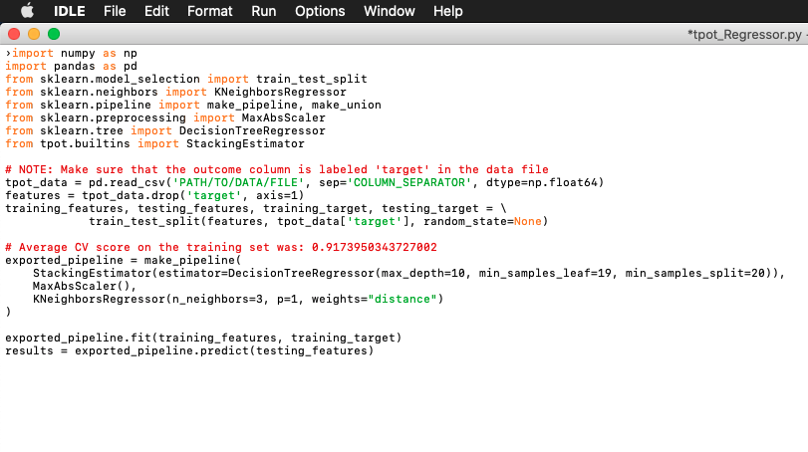
Flask Deployment

Slide 12
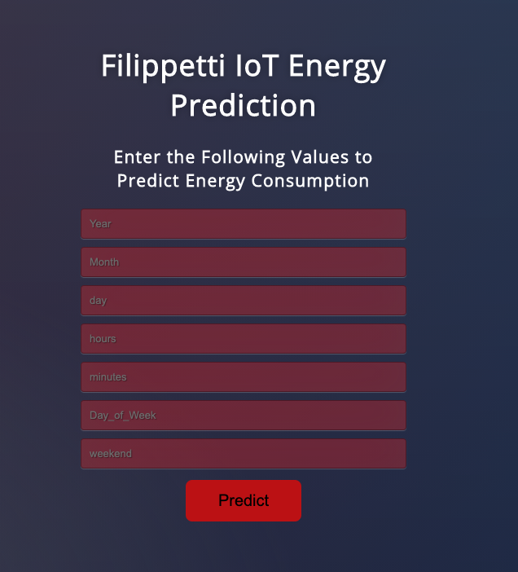

Slide 13
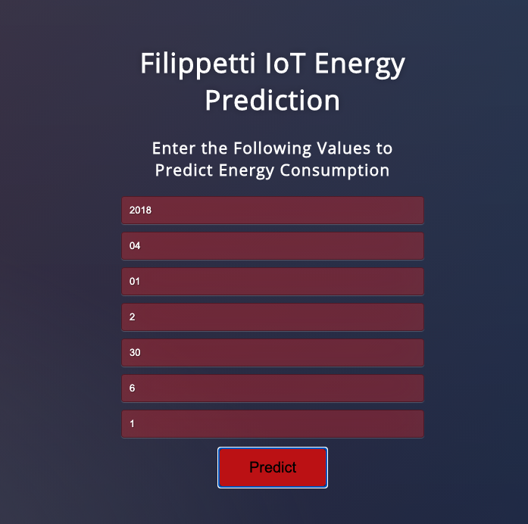
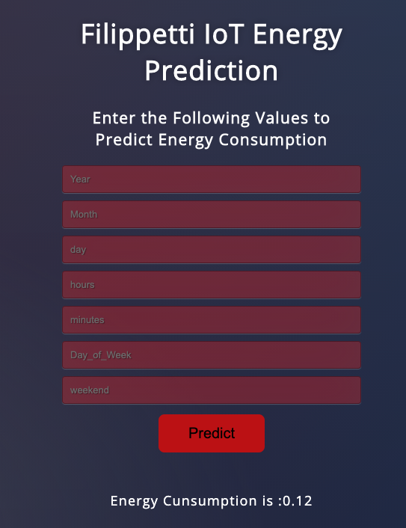
test cases
2018-04-01 02:30:00,0.12411521435460272,2018-04-01,02:30:00,2018,4,1,2,30,Sunday,6,1

Slide 14
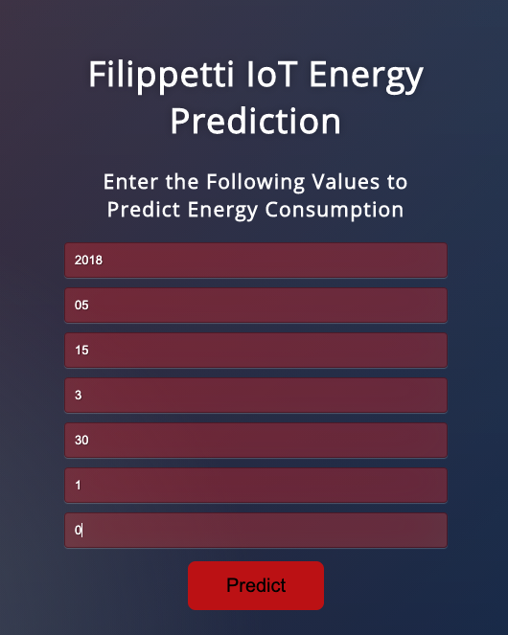
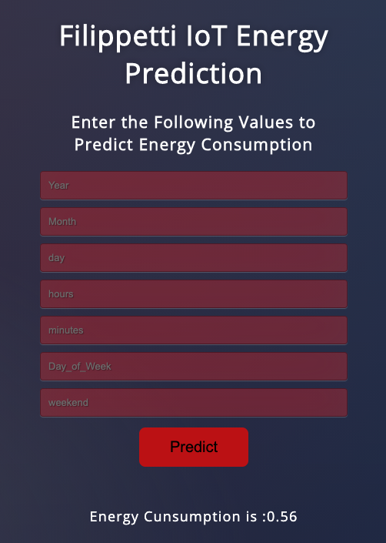
2018-05-15 03:30:00,0.5580178155089293,2018-05-15,03:30:00,2018,5,15,3,30,Tuesday,1,0

Slide 15
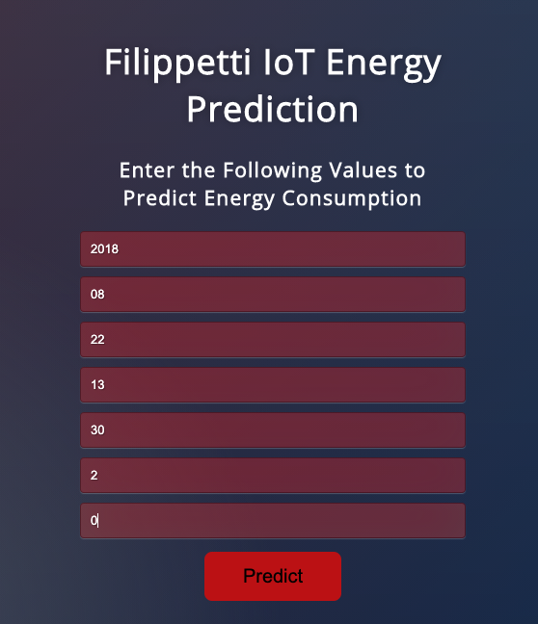
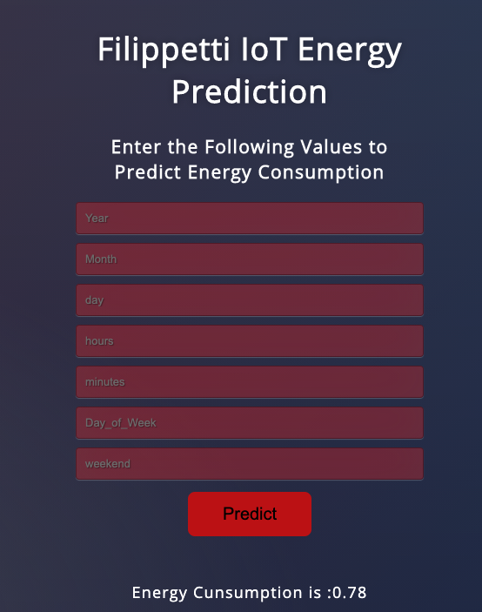
2018-08-22 13:30:00,0.7833607551306403,2018-08-22,13:30:00,2018,8,22,13,30,Wednesday,2,0

Slide 16
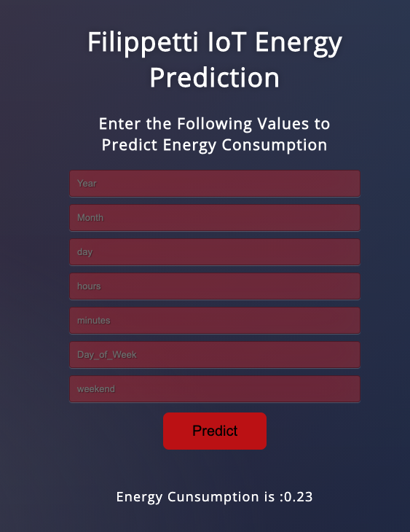
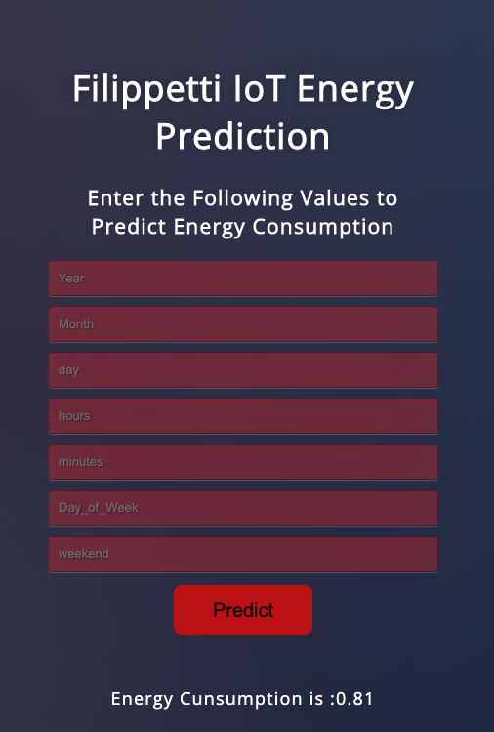
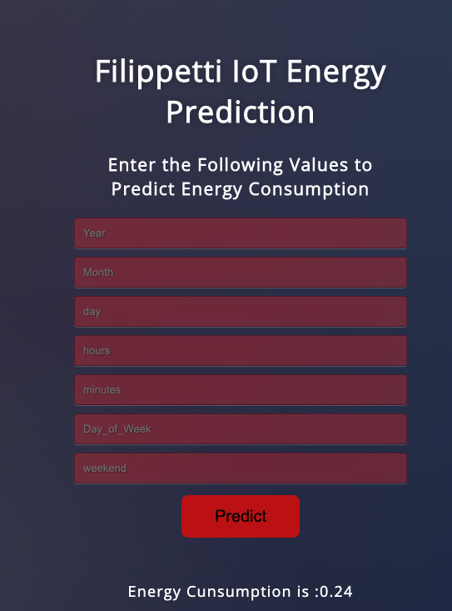
Unseen future test data
2018-09-03 22:30:00,0.207649709777042
2018-09-03 19:30:00,0.9573104664535466
2018-09-01 03:30:00,0.2326216685363729

